Slide 1

Information Flow: From DNA to RNA to Protein
Course: BIO101 (Introduction to Biology)
Part: 1, 2 & 3

Slide 2
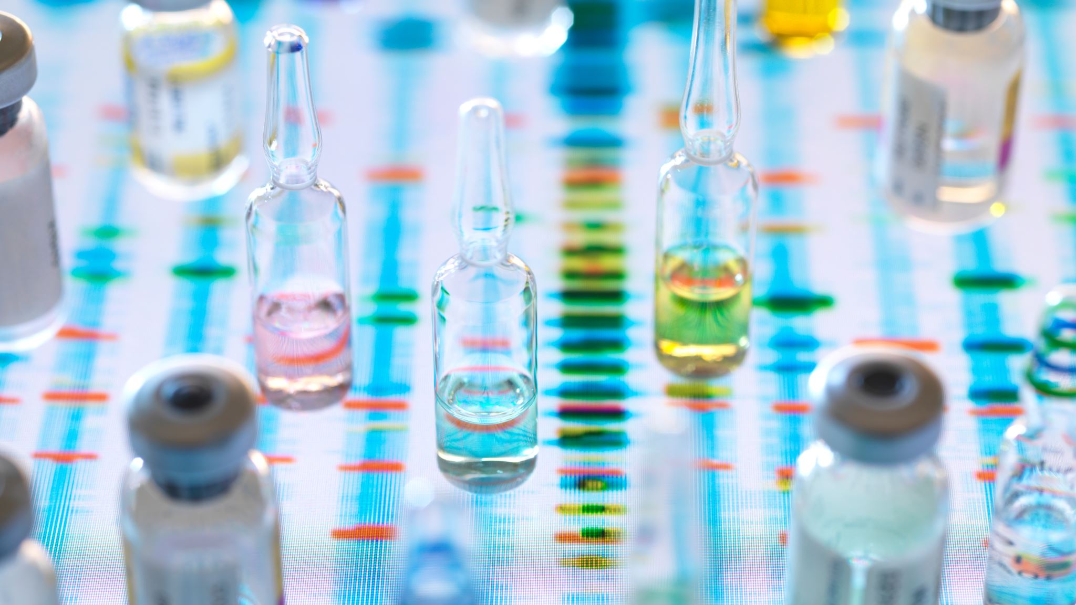
Information Flow: From DNA to RNA to Protein

Slide 3
How an Organism’s Genotype Determines its Phenotype?
Genotype: An organism’s genotype, its genetic makeup, is the heritable information contained in the sequence of nucleotide bases in its DNA.
Phenotype: The phenotype, the organism’s physical traits, arises from the actions of a wide variety of proteins.
Gene: A gene is the basic physical and functional unit of heredity. Genes are made up of DNA and DNA specifies the synthesis of proteins.
Transcription: The transfer of genetic information from DNA into an RNA molecule.
Translation: The transfer of the information from RNA into a polypeptide (protein strand).
The relationship between genes and proteins is thus one of information flow: The function of a DNA.

Slide 4
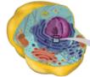

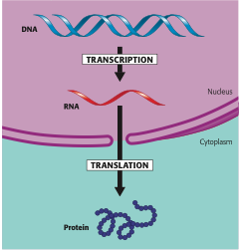
The Flow of Genetic Information in a Eukaryotic Cell
A sequence of nucleotides in the DNA is transcribed into a molecule of RNA in the cell’s nucleus. The RNA travels to the cytoplasm, where it is translated into the specific amino acid sequence of a protein.

Slide 5
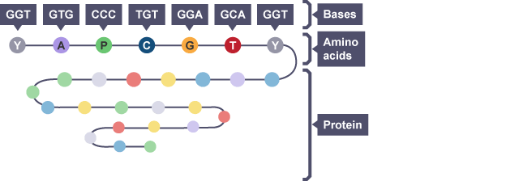
Genetic Information and The Genetic Code
DNA carries the genetic information in the cells of all living organisms. It contains codes for the assembly of amino acids into all the proteins required in the body.
The sequence of bases in a DNA molecule can determine the order of amino acids in a protein molecule. Groups of three bases called triplets represent different amino acids.
This is the basis of the genetic code. There can be 64 (that is, 4³) possible code words of this type—more than enough to specify the 20 amino acids.
The flow of information from gene to protein is based on a triplet code. The genetic instructions for the amino acid sequence of a polypeptide chain are written in DNA and RNA as a series of three-base words called codons.

Slide 6
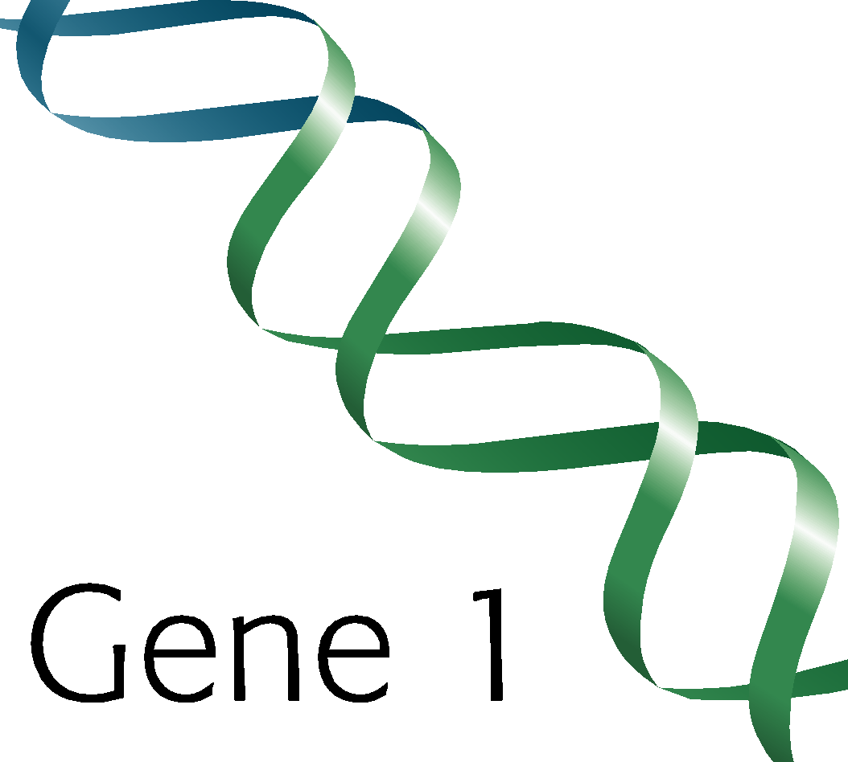
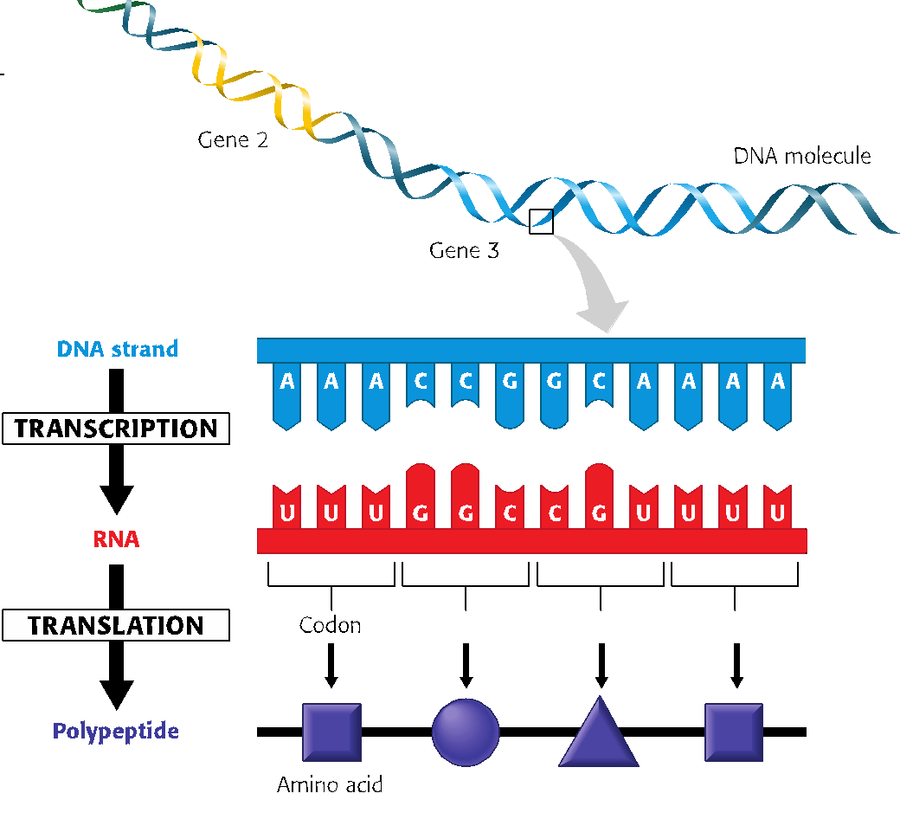
From Nucleotides to Amino Acids: The Flow of Chemical Language of DNA
When a segment of DNA is transcribed, the result is an RNA molecule; here the nucleic acid language of DNA has simply been rewritten (transcribed) as a sequence of bases of RNA; the language is still that of nucleic acids.
Translation is the conversion of the nucleic acid language to the polypeptide language. Like nucleic acids, polypeptides are straight polymers, but the monomers that make them up—the letters of the polypeptide alphabet—are the 20 amino acids common to all organisms.

Slide 7
The Genetic Code
Genetic information is stored in DNA by means of a triplet code that is nearly universal to all living things on Earth.
Each “word” within the mRNA consists of three ribonucleotide letters, thus referred to as a triplet code. With several exceptions, each group of three ribonucleotides, called a codon, specifies one amino acid.
The code contains one "start” and three "stop” signals, triplets that initiate and terminate translation, respectively.
AUG encodes methionine, which initiates most polypeptide chains. All other amino acids except tryptophan, which is encoded only by UGG, are represented by two to six triplets. The triplets UAA, UAG, and UGA are termination signals and do not encode any amino acids.

Slide 8
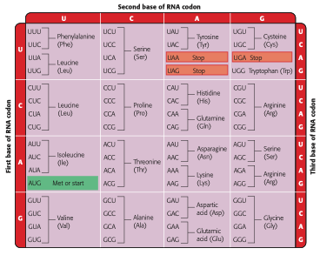
The dictionary of the genetic code
Notice that the codon AUG (highlighted in green) not only stands for the amino acid methionine (Met), but also functions as a signal to “start” translating the RNA at that place. Three of the 64 codons (highlighted in red) function as “stop” signals that mark the end of a genetic message, but do not encode any amino acids.

Slide 9
Transcription is the transfer of genetic information from DNA to RNA. In transcription, only one of the DNA strands serves as a template for the newly forming RNA molecule; the other strand is unused.
The nucleotides that make up the new RNA molecule take their place one at a time along the DNA template strand by forming hydrogen bonds with the nucleotide bases there.
The RNA nucleotides follow the usual base-pairing rules, except that U, rather than T, pairs with A. The RNA nucleotides are linked by the transcription enzyme RNA polymerase.
Transcription: From DNA to RNA

Slide 10
1. Initiation of transcription
The “start transcribing” signal is a nucleotide sequence called a promoter, which is in the DNA at the beginning of the gene. A promoter is a specific place where RNA polymerase attaches. The first phase of transcription, called initiation, is the attachment of RNA polymerase to the promoter and the start of RNA synthesis.
2. RNA Elongation
During the second phase of transcription, elongation, the RNA grows longer. As RNA synthesis continues, the RNA strand peels away from its DNA template, allowing the two separated DNA strands to come back together in the region already transcribed.
3. Termination of transcription
In the third phase, termination, the RNA polymerase reaches a special sequence of bases in the DNA template called a terminator. This sequence signals the end of the gene. At this point, the polymerase molecule detaches from the RNA molecule and the gene, and the DNA strands rejoin.
Overview of The Transcription of An Entire Gene

Slide 11
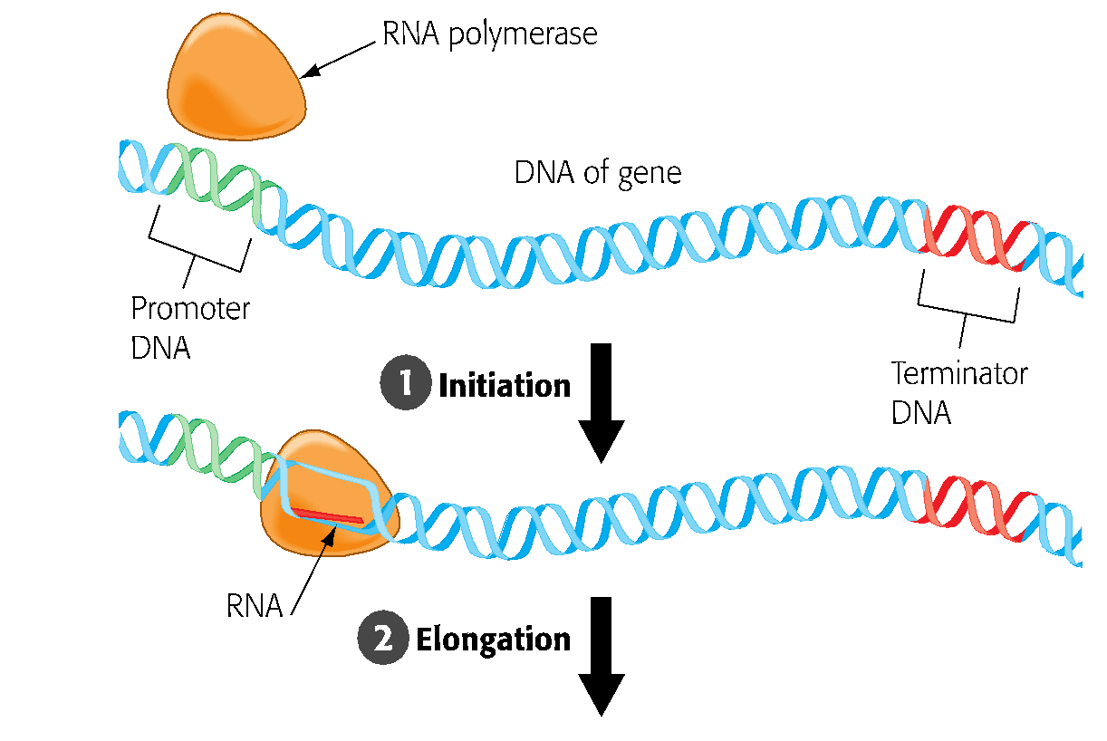
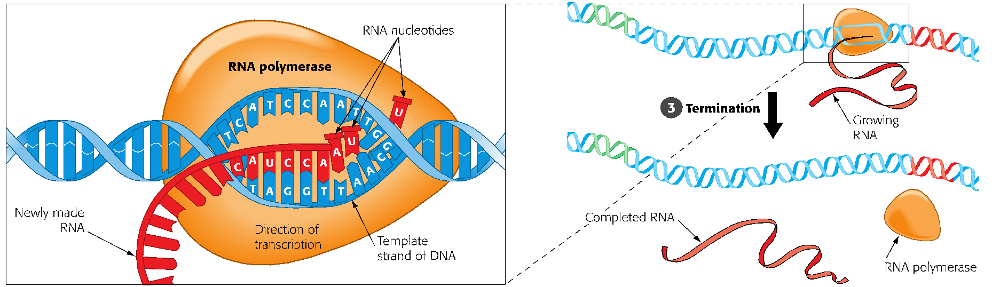
Transcription of a gene. The transcription of an entire gene occurs in three phases: initiation, elongation, and termination of the RNA. The section of DNA where the RNA polymerase starts is called the promoter; the place where it stops is called the terminator.

Slide 12
There are two ways to process eukaryotic mRNA and and make ready for translation: cap and tail, splicing.
Cap and tail is the addition of extra nucleotides to the ends of the RNA transcript. It protects the RNA from attack by cellular enzymes and help ribosomes recognize the RNA as mRNA.
Another type of RNA processing, which is called RNA splicing deals with the two regions of a gene: intron (non-coding) and exon (coding), both exons and introns are transcribed from DNA into RNA. The noncoding stretches of nucleotides interrupt the nucleotides that code for amino acids and need to be removed before the RNA leaves the nucleus and the exons are joined to produce an mRNA molecule with a continuous coding sequence.
RNA splicing is believed to play a significant role in humans in allowing our approximately 21,000 genes to produce many thousands more polypeptides. This is accomplished by varying the exons that are included in the final mRNA.
The Processing of Eukaryotic RNA

Slide 13
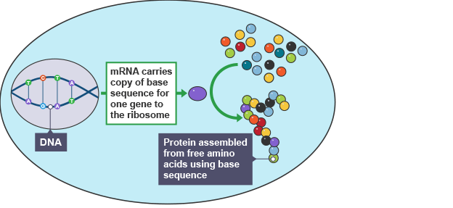
Messenger RNA (mRNA)
In animal, plant and fungal cells, the instructions for making proteins and the structures where proteins are made are found in two different locations. DNA is stored in the nucleus, while proteins are assembled from free amino acids in the cytoplasm in structures called ribosomes.
A chemical called messenger RNA (mRNA) is made in the nucleus and carries a copy of the DNA base sequence of a specific gene to the cytoplasm. Ribosomes attach to the mRNA and the instructions it carries are used to assemble amino acids in the correct order to make a specific protein.

Slide 14
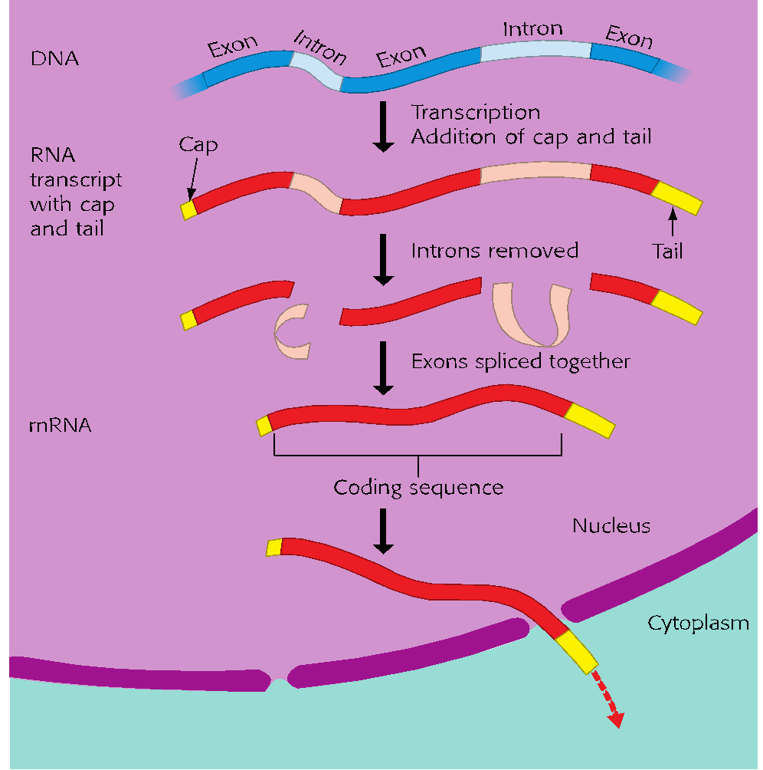
The Production of Messenger RNA (mRNA) in A Eukaryotic Cell
The molecule of mRNA that leaves the nucleus is substantially different from the molecule of RNA that was first transcribed from the gene. In the cytoplasm, the coding sequence of the final mRNA will be translated.

Slide 15
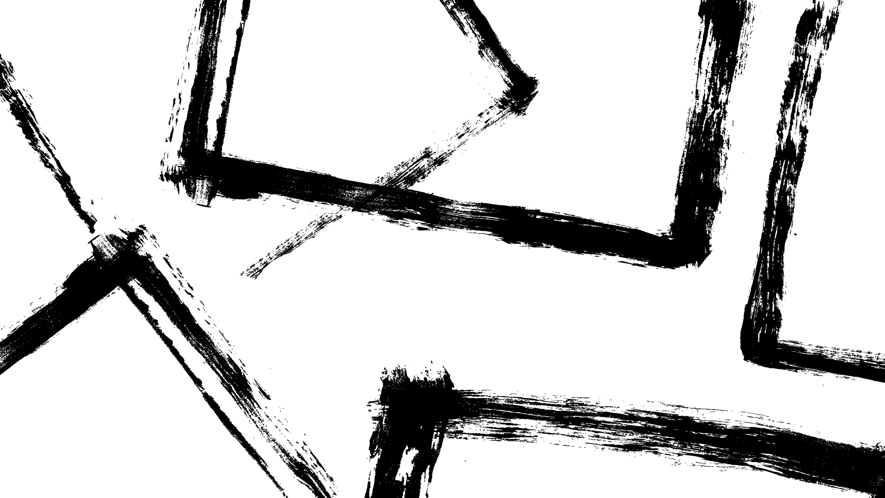
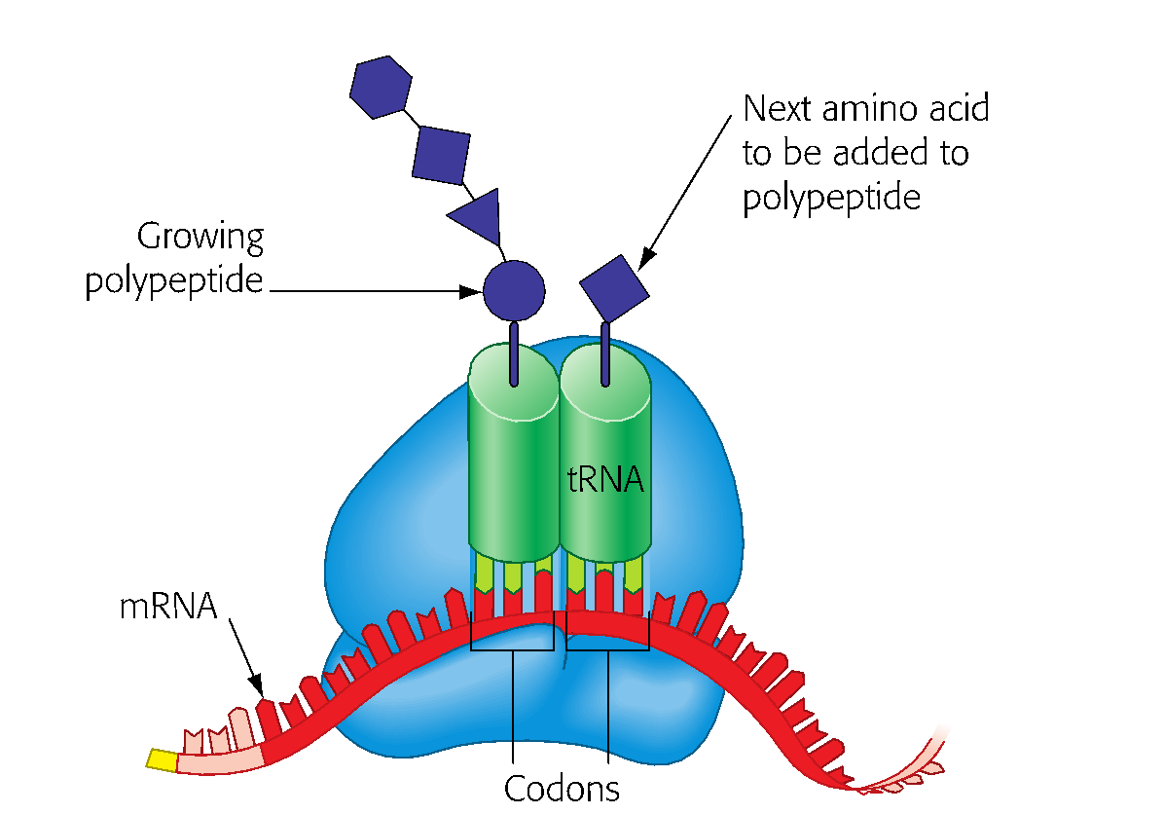
The Players of Translation
Translation is a conversion between different languages—from the nucleic acid language to the protein language. The main players of translation process are:
Messenger RNA (mRNA)
Transfer RNA (tRNA)
Ribosomes
When functioning in polypeptide synthesis, a ribosome holds one molecule of mRNA and two molecules of tRNA. The growing polypeptide is attached to one of the tRNAs.

Slide 16
Translation
In initiation, a ribosome assembles with the mRNA and the initiator tRNA bearing the first amino acid. Beginning at the start codon, the codons of the mRNA are recognized one by one by tRNAs bearing succeeding amino acids. The ribosome bonds the amino acids together. With each addition, the mRNA moves by one codon through the ribosome. When a stop codon is reached, the completed polypeptide is released.

Slide 17
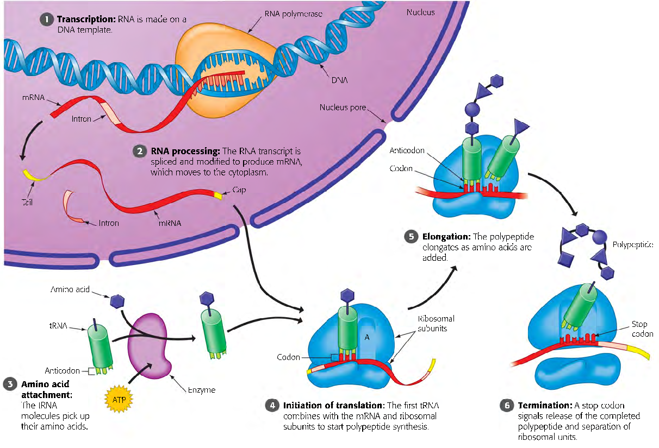
A Summary of Transcription and Translation

Slide 18
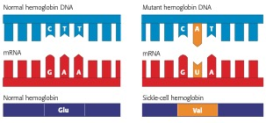
Mutations
Mutations are changes in the DNA base sequence, caused by errors in DNA replication or recombination or by mutagens. Substituting, deleting, or inserting nucleotides in a gene has varying effects on the polypeptide and organism.
Mutations can involve large regions of a chromosome or just a single nucleotide pair, as in sickle-cell disease. The sickle-cell allele differs from its normal counterpart, a gene for hemoglobin, by only one nucleotide. This difference changes the mRNA codon from one that codes for the amino acid glutamic acid (Glu) to one that codes for valine (Val).

Slide 19
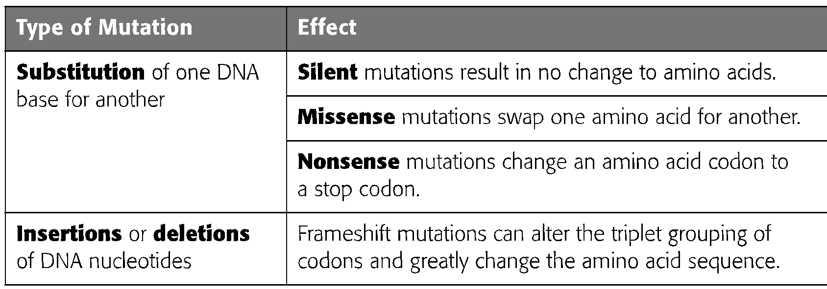
Types of Mutations
Mutations within a gene can be divided into two general categories: nucleotide substitutions and nucleotide insertions or deletions

Slide 20
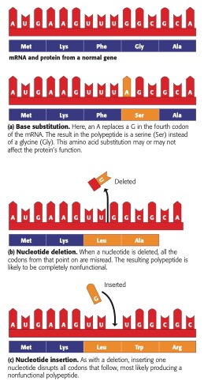
Three Types of Mutations and Their Effects

Slide 21
Mutagens
Mutations can occur in several ways. Spontaneous mutations result from random errors during DNA replication or recombination.
Other sources of mutation are mainly physical and chemical agents known as mutagens. The most common physical mutagen is high- energy radiation, such as X-rays and ultra- violet (UV) light. Chemical mutagens are of various types. One type, for example, consists of chemicals that are like normal DNA bases but that base-pair incorrectly when incorporated into DNA.
Mutagens can act as carcinogens (agents that cause cancer).

Slide 22
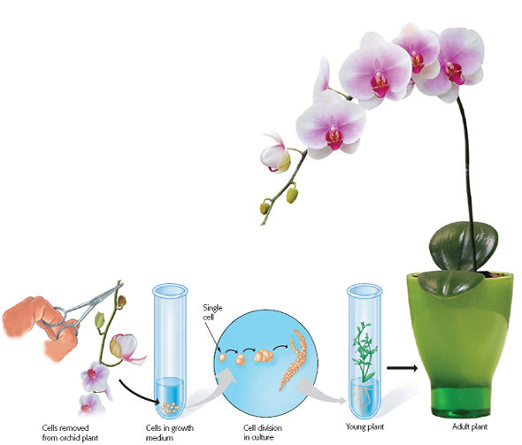
Test-tube cloning of an orchid
The Genetic Potential of Cells
Most differentiated cells retain a complete set of genes, so an orchid plant, for example, can be made to grow from a single orchid cell. Under controlled conditions, animals can also be cloned.
Tissue removed from the stem of an orchid plant and placed in growth medium may begin dividing and eventually grow into an adult plant. The new plant is a genetic duplicate of the parent plant. This process proves that mature plant cells can reverse their differentiation and develop into all the specialized cells of an adult plant.

Slide 23
Reproductive Cloning of Animals
Nuclear transplantation is a procedure whereby a donor cell nucleus is inserted into a nucleus-free egg. First demonstrated in frogs in the 1950s, reproductive cloning was used in 1996 by Scottish researcher Ian Wilmut and his colleagues to clone a sheep from an adult mammary cell and has since been used to create many other cloned animals. This was the first mammal clone, and the cloned sheep was named “Dolly”. The process that was used to clone the sheep is called Somatic Cell Nuclear Transfer (SCNT).

Slide 24
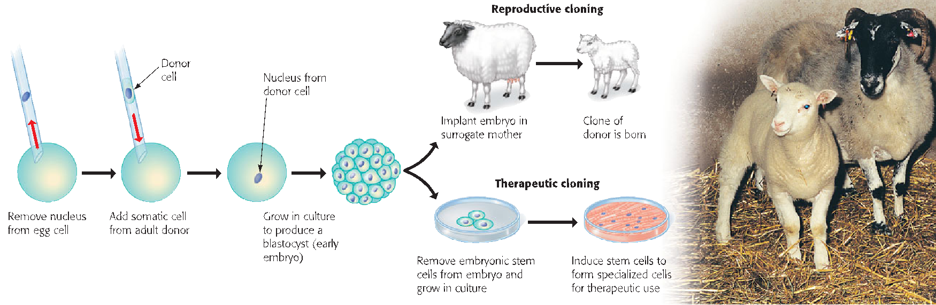
Cloning by SCNT
In nuclear transplantation, a nucleus from an adult body cell is injected into a nucleus-free egg cell. The resulting embryo may then be used to produce a new organism (reproductive cloning, shown in the upper branch) or to provide stem cells (therapeutic cloning, lower branch).

Slide 25
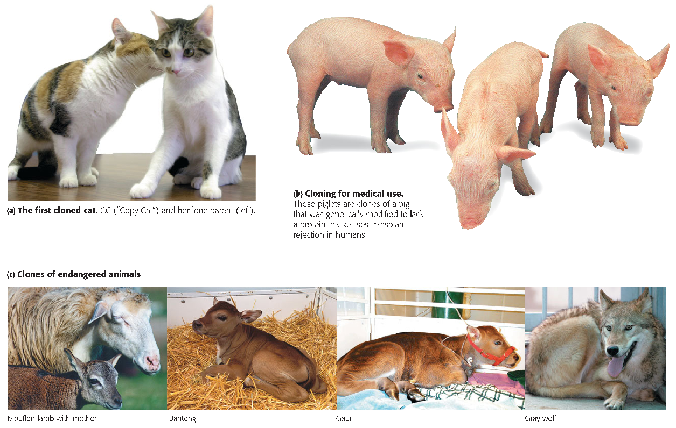
Reproductive Cloning of Mammals

Slide 26
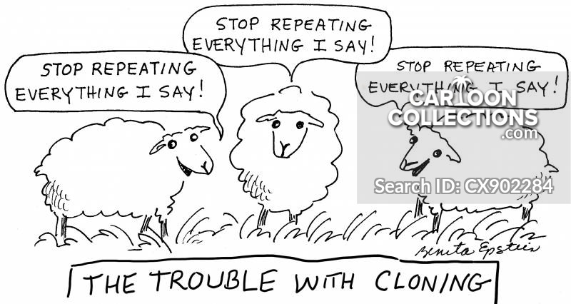
THANK YOU

